Slide 1
Deep High Dynamic Range Imaging with Large
Foreground Motions
Shangzhe Wu, Jiarui Xu, Yu-Wing Tai, and Chi-Keung Tang
The Hong Kong University of Science and Technology
Tencent Youtu
University of Oxford
ECCV 2018
王洪永 19210240183

Slide 2
Background
Network
Experiment
Content

Slide 3
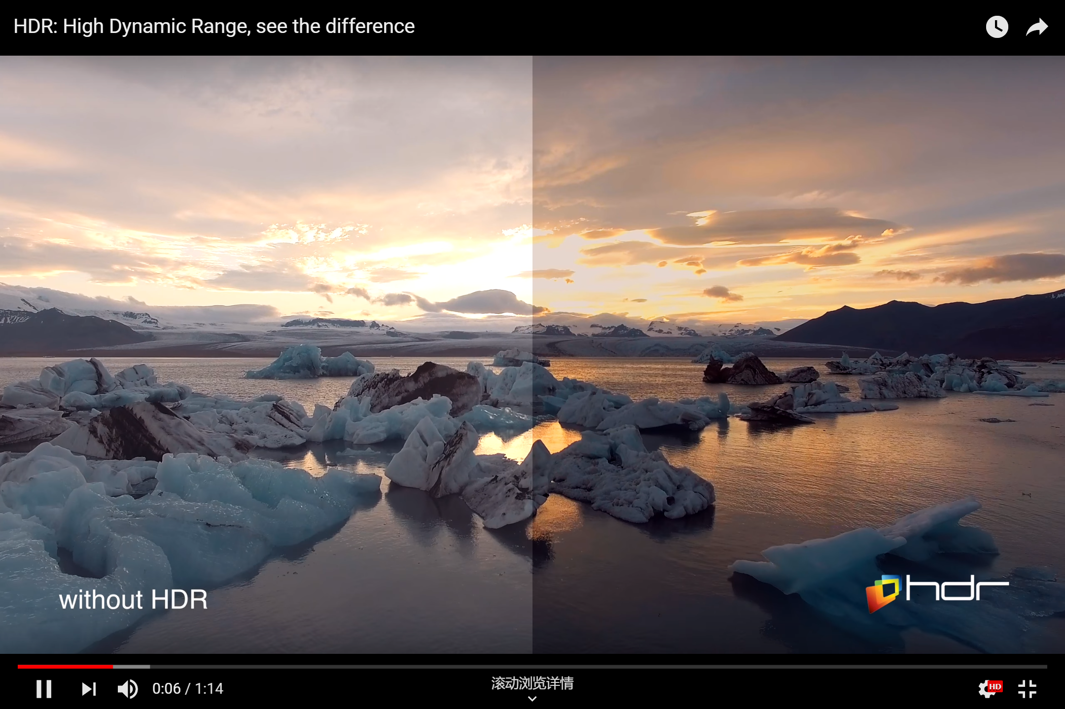



Background
HDR
$$2^{32}$$
LDR
$$2^{8}$$
or
$$2^{16}$$
LDR HDR

Slide 4
Background
Flow-based
LDR images merging
Non-flow-based
Approaches
Special image sensors

Slide 5
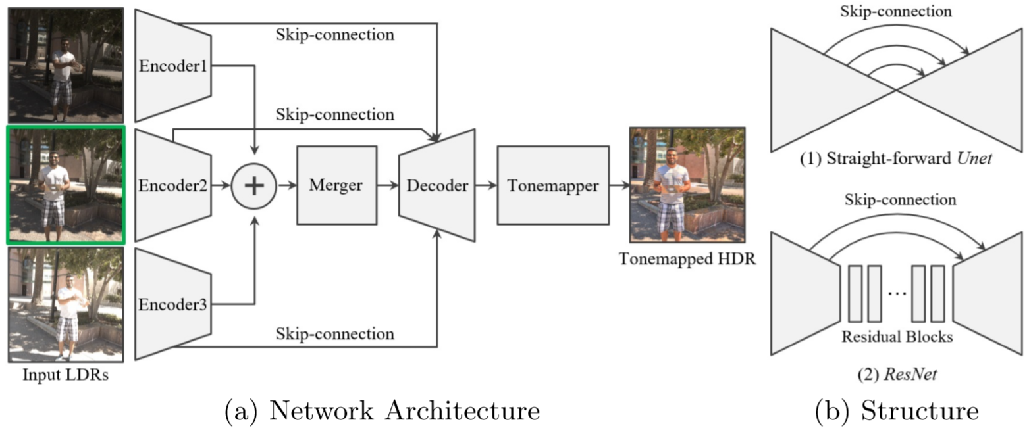
Network

Slide 6

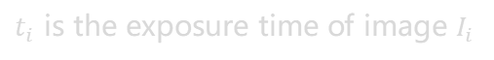



Network
input LDRs
input HDRs
estimated HDR
$$\left\{I_{1}, I_{2}, I_{3}\right\}$$
$$\left\{H_{1}, H_{2}, H_{3}\right\}$$
$$\hat{H}$$
input LDRs to input HDRs by simple gamma encoding
$$H_{i}=\frac{I_{i}^{γ}}{t_{i}}, γ>1$$
$t_{i}$ is the exposure time of image $I_{i}$

Slide 7
Network
CL
5x5 convolution
with Leaky-ReLU
C
B
5x5 convolution
and batch normalize
LR
Leaky-ReLU
skip connection
R⁹
ReLU
and 1x1 convolution
and batch normalize
3x3C
BN
ReLU
3x3C
BN
R
C1
TH
R
TC
B
ReLU
and 5x5 transposed convolution
and batch normalize
concatenate
Network structure

Slide 8




Proposed
compute the loss function on the tonemapped HDR images
µ-law
$$T\left(H\right)=\frac{\log{(1+μH)}}{\log{(1+μ)}}$$
estimated HDR
$$\hat{H}$$
ground truth HDR
$$H$$
loss function:
$L=\left\|T\left(\hat{H}\right)−T(H)\right\|$₂

Slide 9
Experiment
Dataset
Example
one scene one example
three object-motion image
three static image for ground truth
74 training examples
15 testing examples

Slide 10
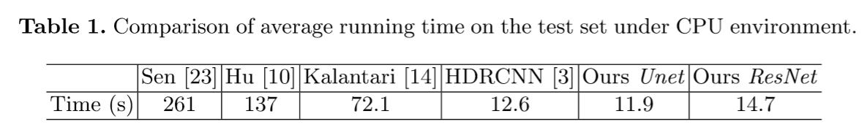
Experiment
PC with i7-4790K (4.0GHz) and 32GB RAM
3 LDR images of size 896×1408 as input

Slide 11
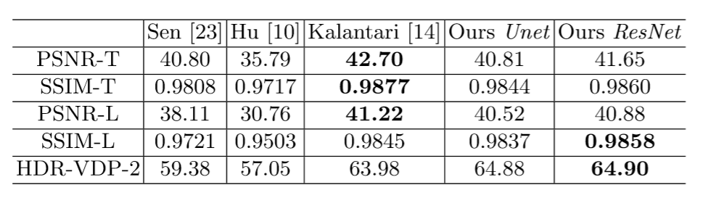
Experiment
Quantitative comparison against the SOTA methods

Slide 12
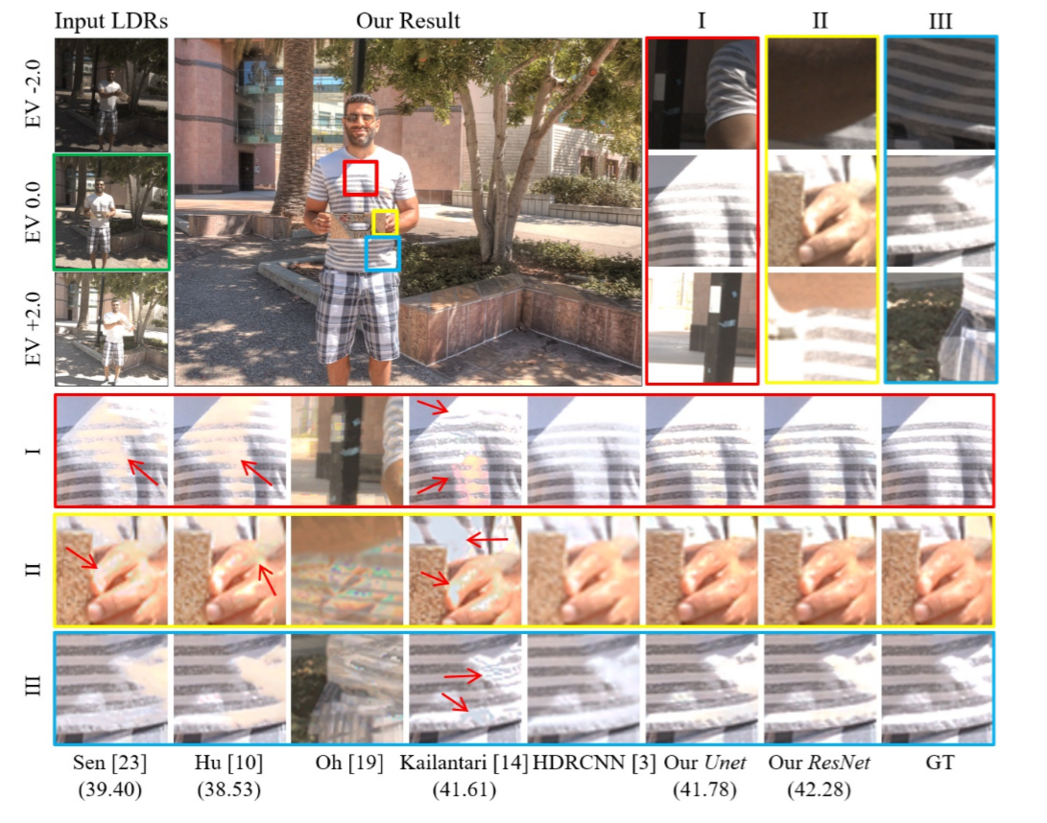
Experiment
Qualitative comparison against the SOTA methods

Slide 13
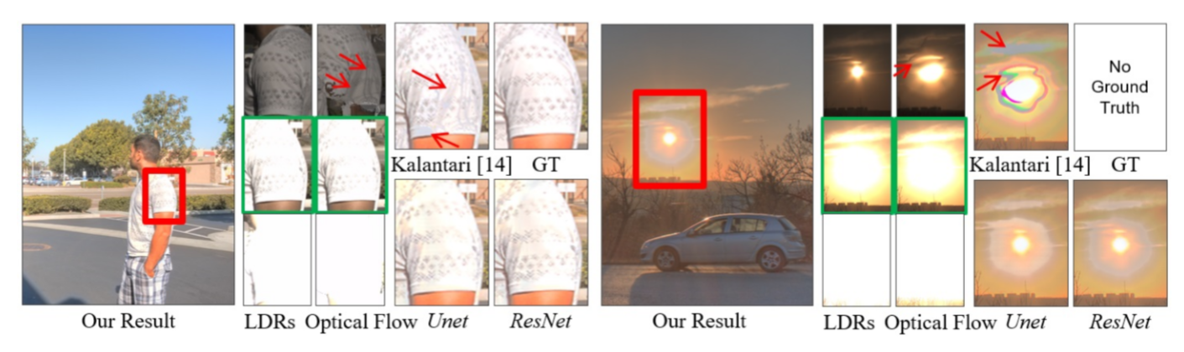
Experiment
Comparison against flow-based method

Slide 14
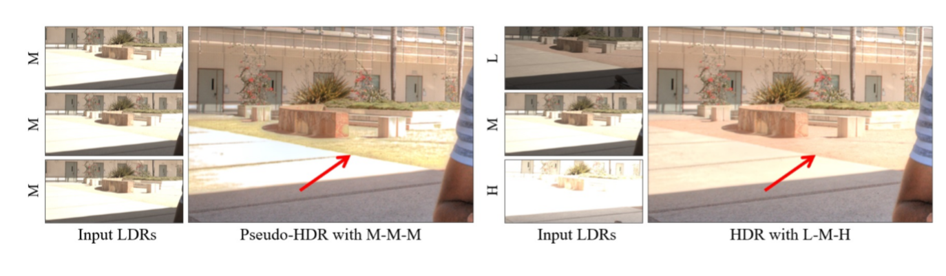
Experiment
Example of hallucination

Slide 15
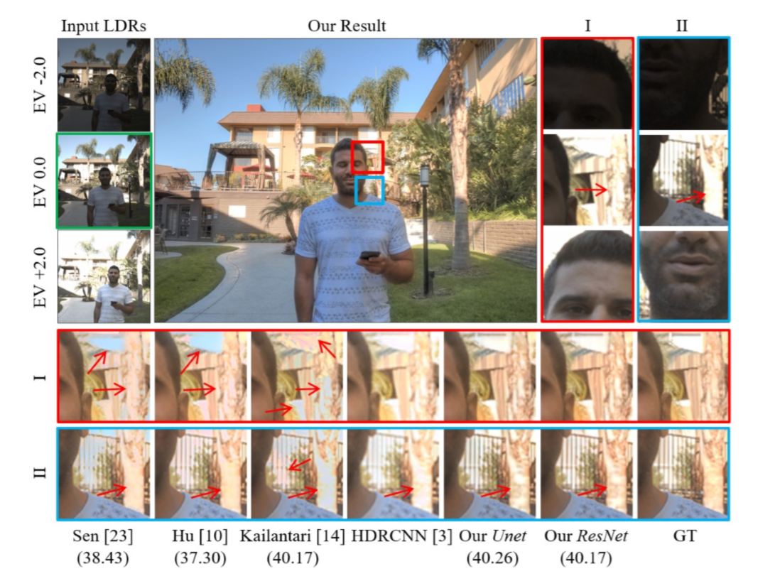
Experiment
Comparison of hallucinated details

Slide 16
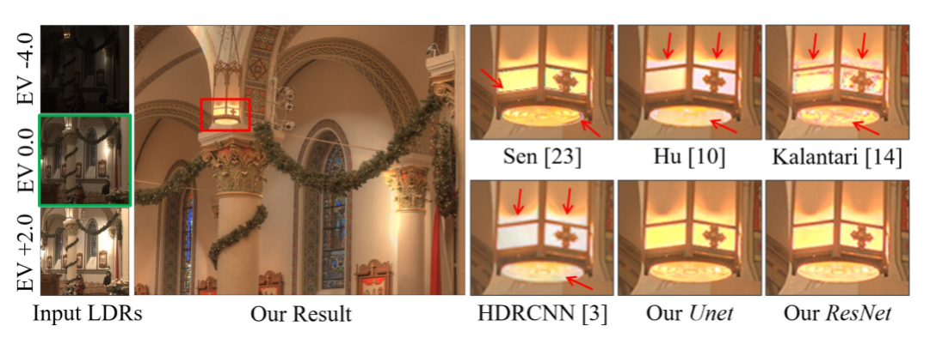
Experiment
Comparison of highlight regions

Slide 17
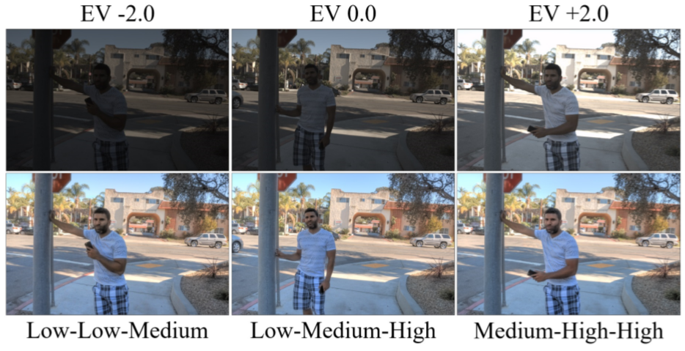
Experiment
Results with diﬀerent reference images

Slide 18
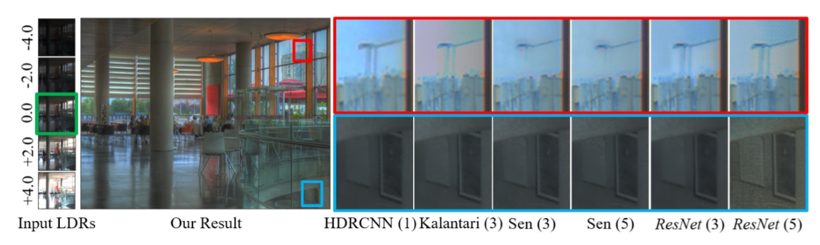
Experiment
Results with more input LDRs

Slide 19
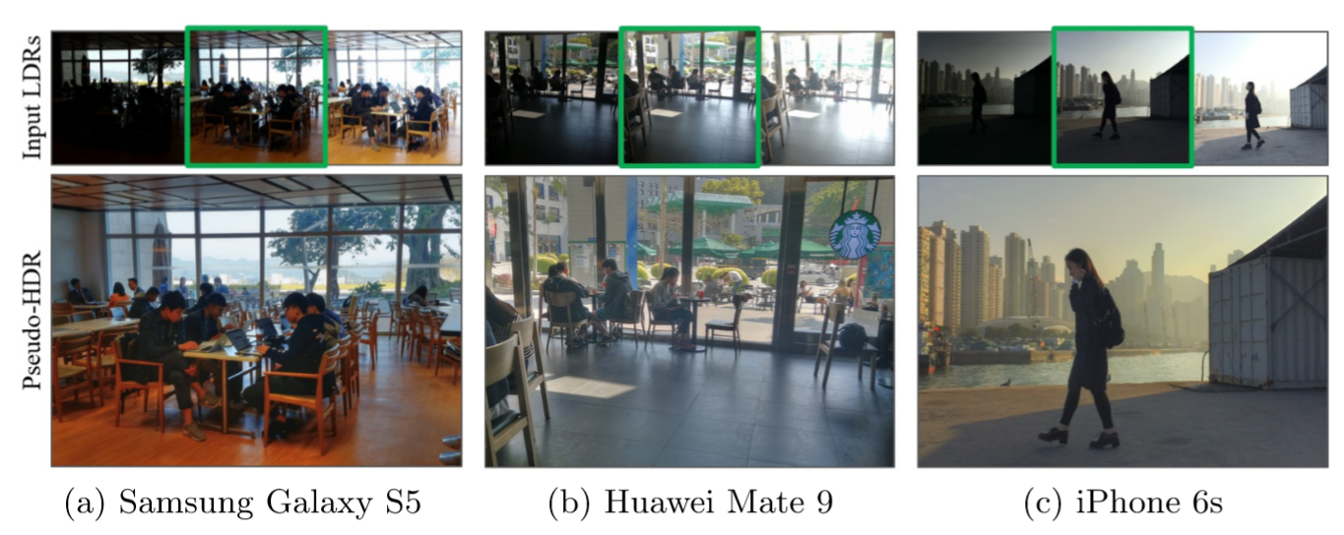
Experiment
Test on cellphone images

Slide 20
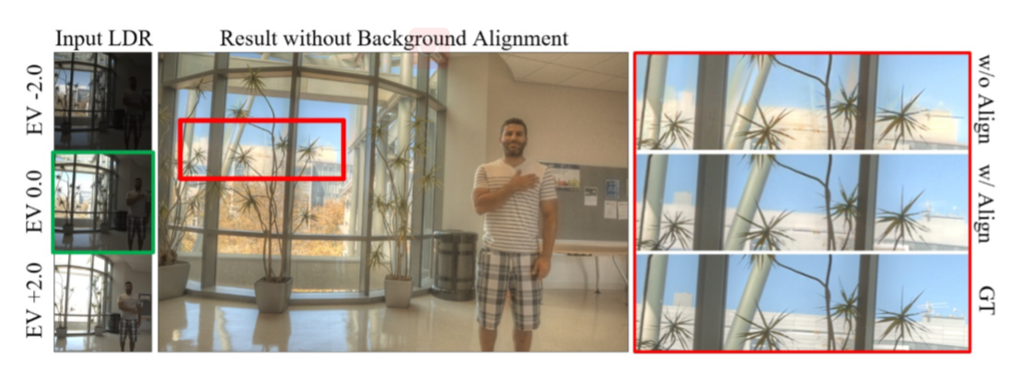
Experiment
The eﬀect of background alignment

Slide 21
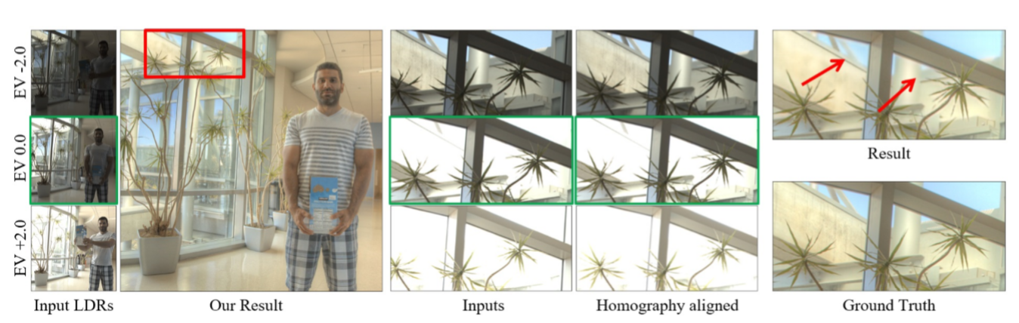
Experiment
Blurry results caused by parallax eﬀects

